Slide 1



Unit 3
Linked List
Prof. Nishtha Srivastava, Assistant Professor,CSE
Prof. Napendra Solanki, Assistant Professor,CSE

Slide 2


CHAPTER-1
What is linked list ?

Slide 3
What is linked list ?
A linked list does not store its elements in consecutive memory locations and the user can add any number of elements to it.
However, unlike an array, a linked list does not allow random access of data.
Elements in a linked list can be accessed only in a sequential manner. But like an array, insertions and deletions can be done at any point in the list in a constant time.
A linked list, in simple terms, is a linear collection of data elements. These data elements are called nodes.

Slide 4
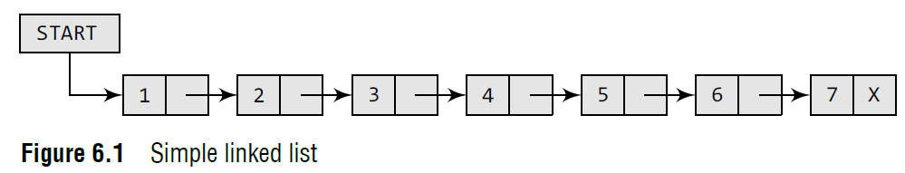
Structure of Link List
A linked list can be perceived as a train or a sequence of nodes in which each node contains one or more data fields and a pointer to the next node.
In Fig. 6.1, we can see a linked list in which every node contains two parts, an integer and a pointer to the next node.
The left part of the node which contains data may include a simple data type, an array, or a structure.

Slide 5
Structure of Link List
4. The right part of the node contains a pointer to the next node (or address of the next node in sequence).
5. The last node will have no next node connected to it, so it will store a special value called NULL.
6. In Fig. 6.1, the NULL pointer is represented by X.

Slide 6
Link List in C Program
In C, we can implement a linked list using the following code:
struct node
{
int data;
struct node *next;
};

Slide 7
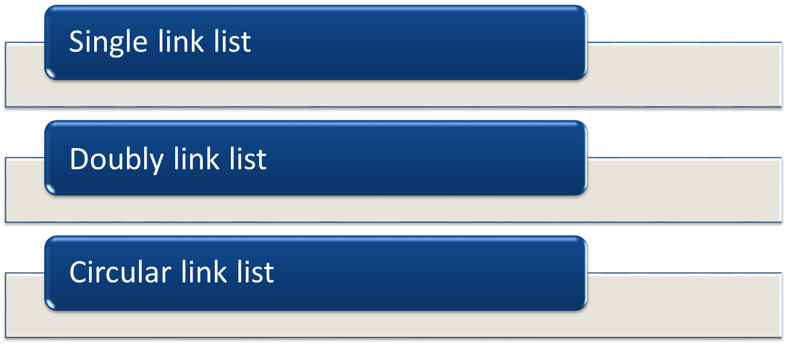
Types of Link List

Slide 8



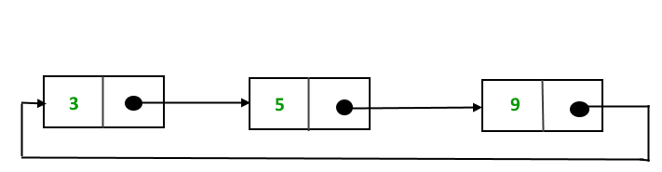
Types of Link List

Slide 9
Operations in Link List
Traversing list : accessing the nodes of the list in order to perform some processing on them.
Insert element in link list
Delete element from link list
Search for element in link list

Slide 10
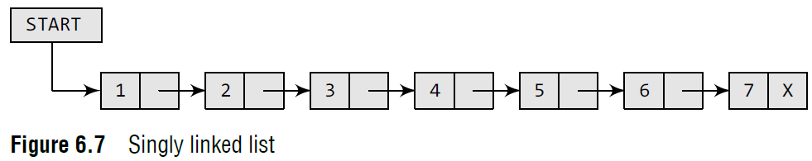
Traversing Single Link List
Traversing a linked list means accessing the nodes of the list in order to perform some processing on them.
A linked list always contains a pointer variable START which stores the address of the first node of the list.
We also make use of another pointer variable PTR which points to the node that is currently being accessed.

Slide 11
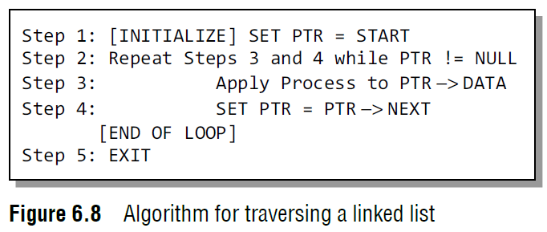
Traversing Single Link List

Slide 12
Traversing Single Link List
In this algorithm, we first initialize PTR with the address of START. So now, PTR points to the first node of the linked list.
Then in Step 2, a while loop is executed which is repeated till PTR processes the last node, that is until it encounters NULL.
In Step 3, we apply the process (e.g., print) to the current node, that is, the node pointed by PTR.
In Step 4, we move to the next node by making the PTR variable point to the node whose address is stored in the NEXT field.

Slide 13
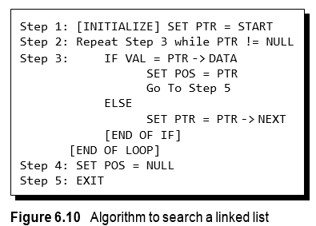
Searching : Single Link List
In Step 1, we initialize the pointer variable PTR with START that contains the address of the first node.
In Step 2, a while loop is executed which will compare every node’s DATA with VAL for which the search is being made. If the search is successful, that is, VAL has been found, then the address of that node is stored in POS and the control jumps to the last statement of the algorithm.
However, if the search is unsuccessful, POS is set to NULL which indicates that VAL is not present in the linked list.

Slide 14
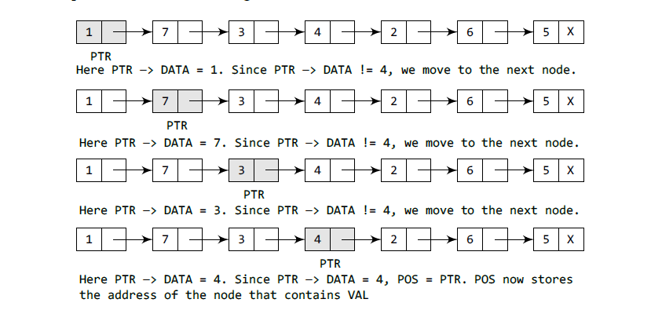
Searching : Single Link List

Slide 15
Insertion : Single Link List
Case 1: The new node is inserted at the beginning.
Case 2: The new node is inserted at the end.
Case 3: The new node is inserted after a given node.

Slide 16
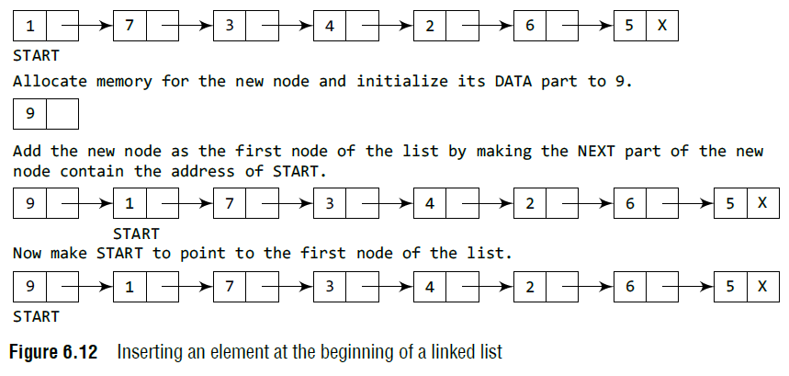
Case 1 :The new node is inserted at the beginning.

Slide 17
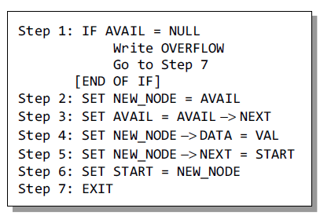
Case 1 :The new node is inserted at the beginning.
In Step 1, we first check whether memory is available for the new node.
If a free memory cell is available, then we allocate space for the new node. Set its DATA part with the given VAL and the NEXT part is initialized with the address of the first node of the list, which is stored in START
Now, since the new node is added as the first node of the list, it will now be known as the START node, that is, the START pointer variable will now hold the address of the NEW_NODE.

Slide 18
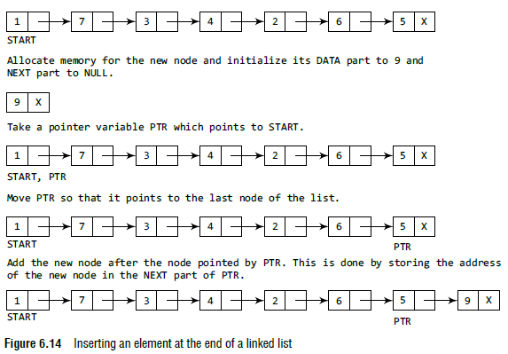
Case 2 :The new node is inserted at the end.

Slide 19
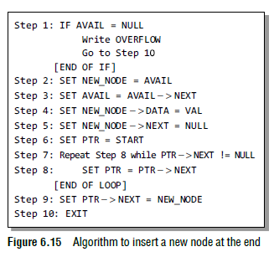
Case 2 :The new node is inserted at the end.
In Step 6, we take a pointer variable PTR and initialize it with START.
That is, PTR now points to the first node of the linked list. In the while loop, we traverse through the linked list to reach the last node.
Once we reach the last node, in Step 9, we change the NEXT pointer of the last node to store the address of the new node.
Remember that the NEXT field of the new node contains NULL, which signifies the end of the linked list.

Slide 20
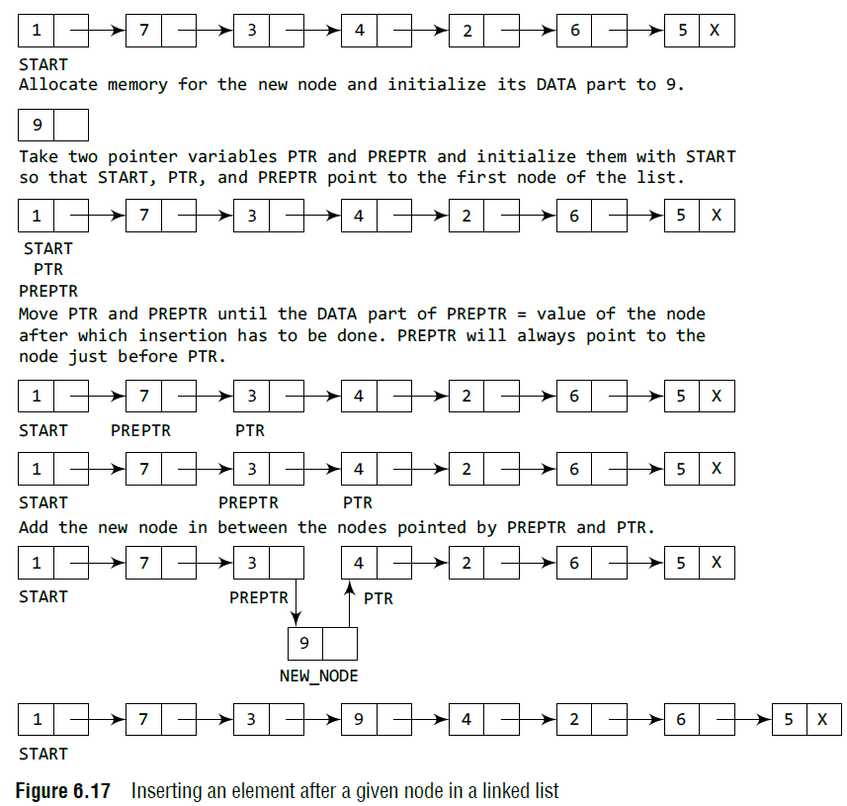
Case 3 :The new node is inserted in between.

Slide 21
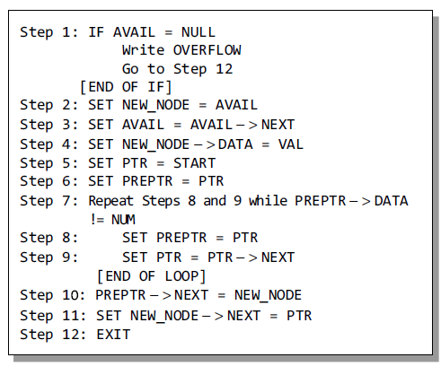
Case 3 :The new node is inserted in between.
In Step 5, we take a pointer variable PTR and initialize it with START. That is, PTR now points to the first node of the linked list.
Then we take another pointer variable PREPTR which will be used to store the address of the node preceding PTR.
Initially, PREPTR is initialized to PTR.
So now, PTR, PREPTR, and START are all pointing to the first node of the linked list.
In the while loop, we traverse through the linked list to reach the node that has its value equal to NUM.
We need to reach this node because the new node will be inserted after this node. Once we reach this node, in Steps 10 and 11, we change the NEXT pointers in such a way that new node is inserted after the desired node.

Slide 22
Single Link List : Deletion
Case 1: Delete first node
Case 2: Delete last node
Case 3: Delete from between

Slide 23
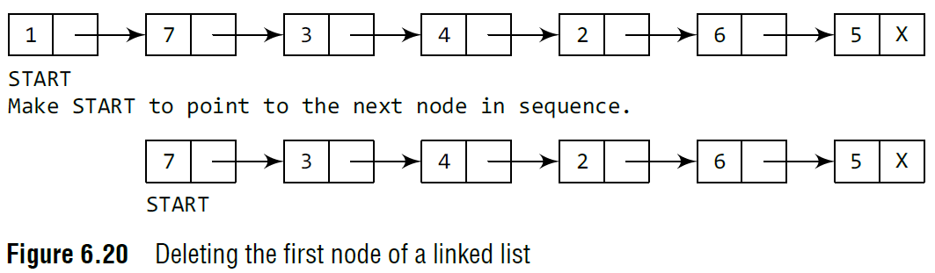
Case 1 : Delete first node

Slide 24
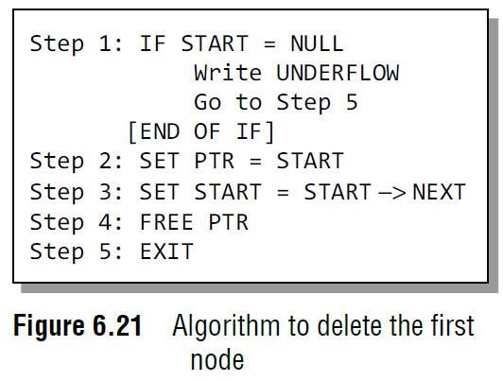
Case 1 : Delete first node
In Step 1, we check if the linked list exists or not. If START = NULL, then it signifies that there are no nodes in the list and the control is transferred to the last statement of the algorithm.
However, if there are nodes in the linked list, then we use a pointer variable PTR that is set to point to the first node of the list.
For this, we initialize PTR with START that stores the address of the first node of the list.
In Step 3, START is made to point to the next node in sequence and finally the memory occupied by the node pointed by PTR (initially the first node of the list) is freed and returned to the free pool.

Slide 25
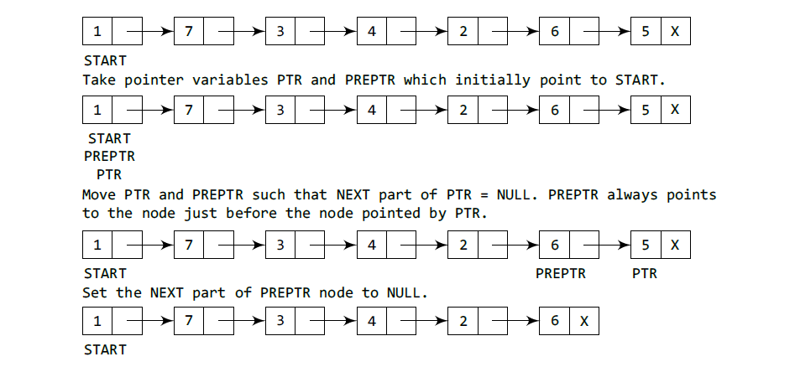
Case 2 : Deleting Last Node from Link List

Slide 26
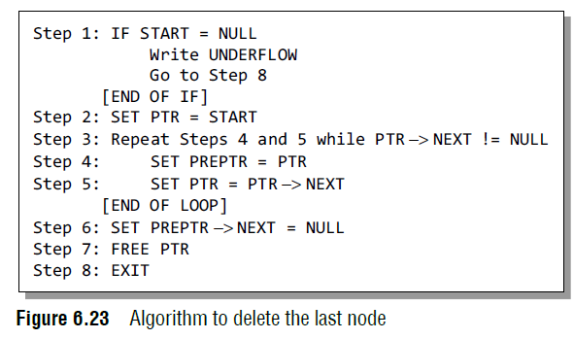
Case 2 : Deleting Last Node from Link List

Slide 27
Case 2 : Deleting Last Node from Link List
Figure shows the algorithm to delete the last node from a linked list.
In Step 2, we take a pointer variable PTR and initialize it with START. That is, PTR now points to the first node of the linked list.
In the while loop, we take another pointer variable PREPTR such that it always points to one node before the PTR.
Once we reach the last node and the second last node, we set the NEXT pointer of the second last node to NULL, so that it now becomes the (new) last node of the linked list.
The memory of the previous last node is freed and returned back to the free pool.

Slide 28
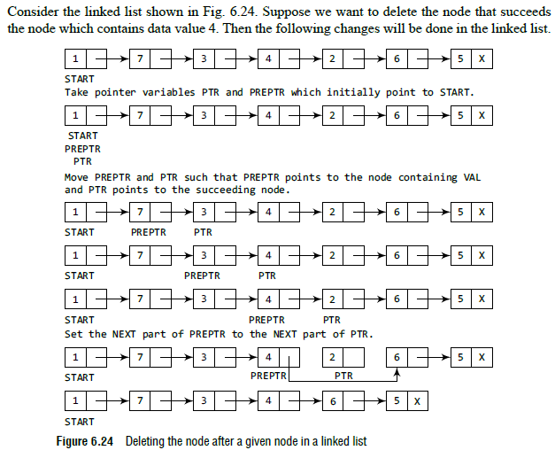
Case 3 :Deleting Node after a given position in Linked List

Slide 29
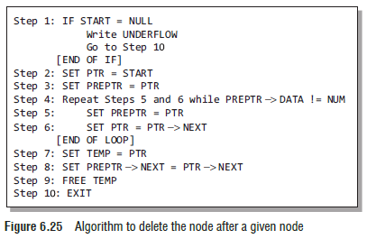
Case 3 :Deleting Node after a given position in Linked List

Slide 30
Case 3 :Deleting Node after a given position in Linked List
Figure shows the algorithm to delete the node after a given node from a linked list.
In Step 2, we take a pointer variable PTR and initialize it with START. That is, PTR now points to the first node of the linked list. In the while loop, we take another pointer variable PREPTR such that it always points to one node before the PTR.
Once we reach the node containing VAL and the node succeeding it, we set the next pointer of the node containing VAL to the address contained in next field of the node succeeding it. The memory of the node succeeding the given node is freed and returned back to the free pool.

Slide 31
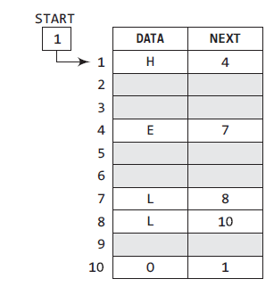
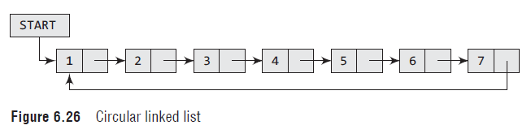
Circular Linked List
In a circular linked list, the last node contains a pointer to the first node of the list.

Slide 32
Circular Link List- Insertion
Case 1: The new node is inserted at the beginning of the circular linked list.
Case 2: The new node is inserted at the end of the circular linked list.

Slide 33
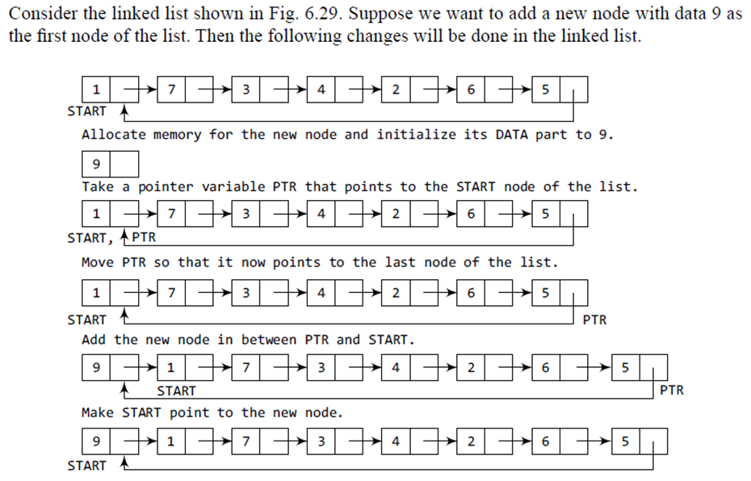
Case 1: The new node is inserted at the beginning of the circular linked list.

Slide 34
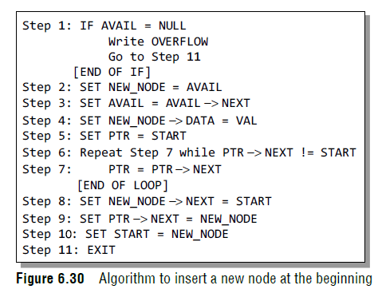
Case 1: The new node is inserted at the beginning of the circular linked list.
Step 1, we first check whether memory is available for the new node
If free memory cell is available, then we allocate space for the new node. Set its DATA part with the given VAL and the NEXT part is initialized with the address of the first node of the list, which is stored in START.
The START pointer variable will now hold the address of the NEW_NODE.
While inserting a node in a circular linked list, we have to use a while loop to traverse to the last node of the list. Because the last node contains a pointer to START, its NEXT field is updated so that after insertion it points to the new node which will be now known as START.

Slide 35
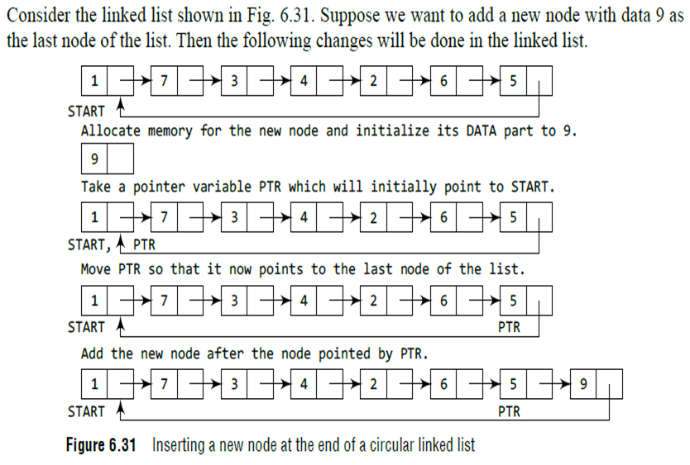
Insert node at end of circular link list

Slide 36
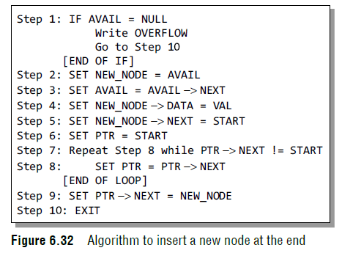
Insert node at end of circular link list
In Step 6, we take a pointer variable PTR and initialize it with START. That is, PTR now points to the first node of the linked list.
In the while loop, we traverse through the linked list to reach the last node.
Once we reach the last node, in Step 9, we change the NEXT pointer of the last node to store the address of the new node.
Remember that the NEXT first of the new node contains the address of the fi node which is denoted by START.

Slide 37
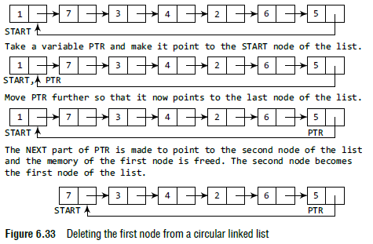
Delete first node of circular link list

Slide 38
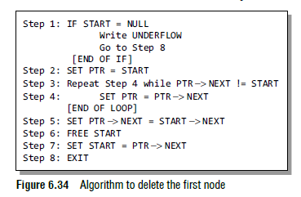
Delete first node of circular link list
In Step 1 of the algorithm, we check if the linked list exists or not. If START = NULL, then it signifies that there are no nodes in the list and the control is transferred to the last statement of the algorithm.
However, if there are nodes in the linked list, then we use a pointer variable PTR which will be used to traverse the list to ultimately reach the last node.
In Step 5, we change the next pointer of the last node to point to the second node of the circular linked list. In Step 6, the memory occupied by the first node is freed.
Finally, in Step 7, the second node now becomes the first node of the list and its address is stored in the pointer variable START

Slide 39
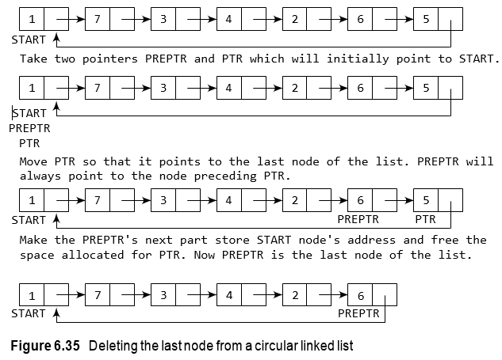
Delete last node of circular link list

Slide 40
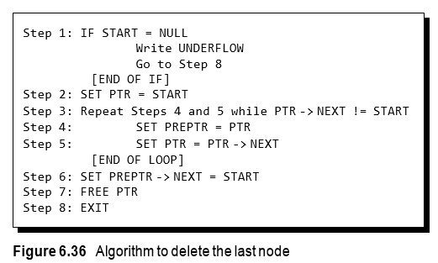
Delete last node of circular link list

Slide 41
Delete last node of circular link list
In Step 2, we take a pointer variable PTR and initialize it with START. That is, PTR now points to the fi node of the linked list. In the while loop, we take another pointer variable PREPTR such that PREPTR always points to one node before PTR.
Once we reach the last node and the second last node, we set the next pointer of the second last node to START, so that it now becomes the (new) last node of the linked list. The memory of the previous last node is freed and returned to the free pool.

Slide 42
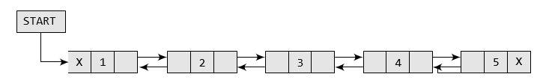
Doubly link list
A doubly linked list or a two-way linked list is a more complex type of linked list which contains a pointer to the next as well as the previous node in the sequence.

Slide 43
Doubly link list
In C, the structure of a doubly linked list can be given as,
struct node
{
struct node *prev; int data;
struct node *next;
};
The PREV field of the first node and the NEXT field of the last node will contain NULL. The PREV field is used to store the address of the preceding node, which enables us to traverse the list in the backward direction.

Slide 44
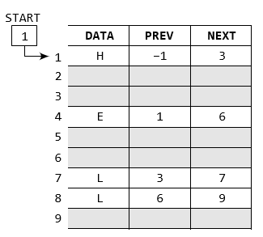
Memory representation of doubly link list
START is used to store the address of the first node
We reach a position where the NEXT entry contains –1 or NULL. This denotes the end of the linked list.
When we traverse the DATA and NEXT in this manner, we will finally see that the linked list in the above example stores characters that when put together form the word HELLO.

Slide 45
Insertion in doubly link list
Case 1: The new node is inserted at the beginning.
Case 2: The new node is inserted at the end.
Case 3: The new node is inserted after a given node.

Slide 46
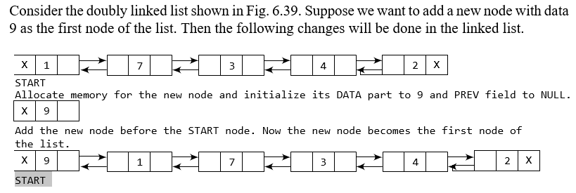
Case 1: The new node is inserted at the beginning.

Slide 47
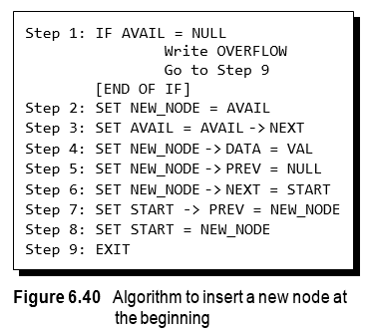
Case 1: The new node is inserted at the beginning.
In Step 1, we first check whether memory is available for the new node. If the free memory has exhausted, then an OVERFLOW message is printed.
Otherwise, if free memory cell is available, then we allocate space for the new node. Set its DATA part with the given VAL and the NEXT part is initialized with the address of the first node of the list, which is stored in START.
Now, since the new node is added as the first node of the list, it will now be known as the START node, that is, the START pointer variable will now hold the address of NEW_NODE.

Slide 48
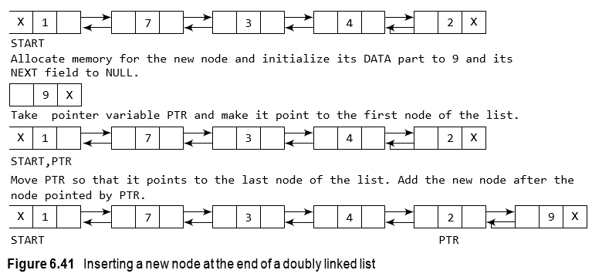
Case 2: The new node is inserted at the end.
Suppose we want to add new node with data 9 as the last node of the list. Then the following changes will be done in the linked list.

Slide 49
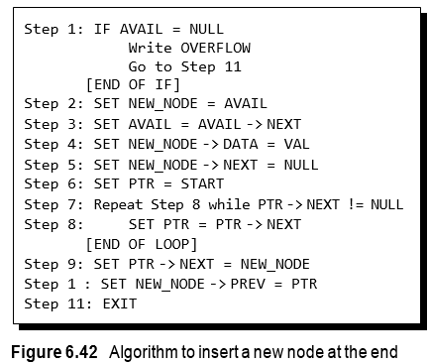
Case 2: The new node is inserted at the end.
In Step 6, we take a pointer variable PTR and initialize it with START.
In the while loop, we traverse through the linked list to reach the last node.
Once we reach the last node, in Step 9, we change the NEXT pointer of the last node to store the address of the new node.
Remember that the NEXT field of the new node contains NULL which signifies the end of the linked list. The PREV field of the NEW_NODE will be set so that it points to the node pointed by PTR (now the second last node of the list).

Slide 50
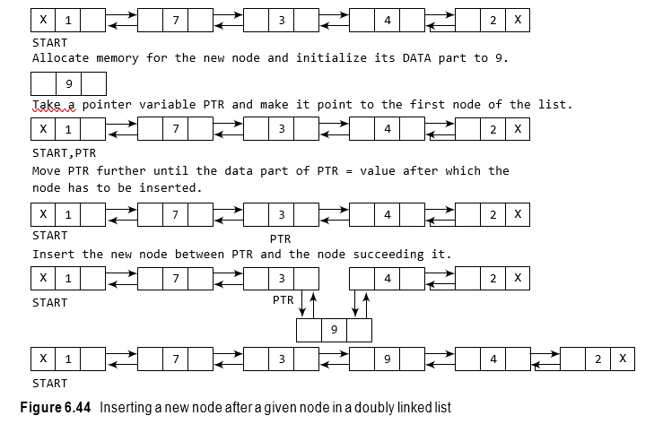
Case 3: The new node is inserted after a given node.

Slide 51
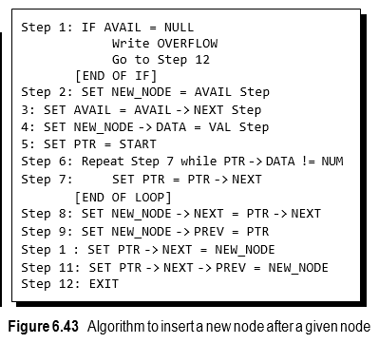
Case 3: The new node is inserted after a given node.
In Step 5, we take a pointer PTR and initialize it with START. That is, PTR now points to the first node of the linked list.
In the while loop, we traverse through the linked list to reach the node that has its value equal to NUM. We need to reach this node because the new node will be inserted after this node.
Once we reach this node, we change the NEXT and PREV fields in such a way that the new node is inserted after the desired node.

Slide 52
Deletion in doubly link list
Case 1: The first node is deleted.
Case 2: The last node is deleted.
Case 3: The node after a given node is deleted.

Slide 53
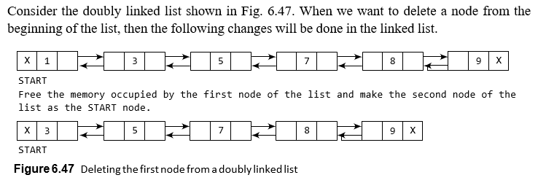
Case 1: The first node is deleted in doubly link list

Slide 54
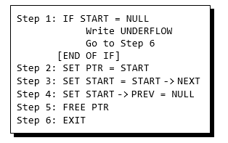
Case 1: The first node is deleted in doubly link list
In Step 1 of the algorithm, we check if the linked list exists or not. If START = NULL, then it signifies that there are no nodes in the list and the control is transferred to the last statement of the algorithm.
However, if there are nodes in the linked list, then we use a temporary pointer variable PTR that is set to point to the first node of the list.
For this, we initialize PTR with START that stores the address of the first node of the list.
In Step 3, START is made to point to the next node in sequence and finally the memory occupied by PTR (initially the first node of the list) is freed and returned to the free pool

Slide 55
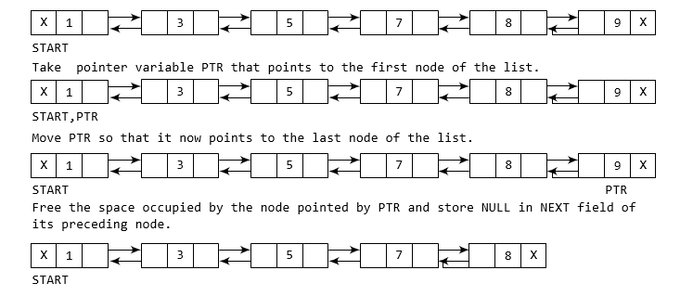
Case 2: The last node is deleted in doubly link list

Slide 56
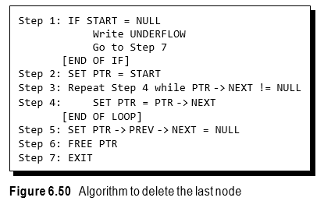
Case 2: The last node is deleted in doubly link list
In Step 2, we take a pointer variable PTR and initialize it with START. That is, PTR now points to the first node of the linked list.
The while loop traverses through the list to reach the last node. Once we reach the last node, we can also access the second last node by taking its address from the PREV field of the last node.
To delete the last node, we simply have to set the next fi of second last node to NULL, so that it now becomes the (new) last node of the linked list. The memory of the previous last node is freed and returned to the free pool.

Slide 57
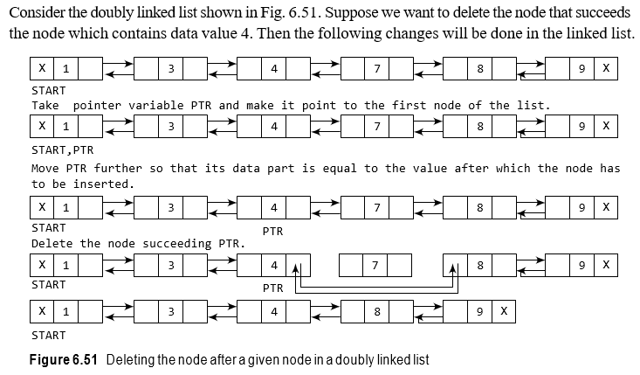
Case 3: The node after a given node is deleted.

Slide 58
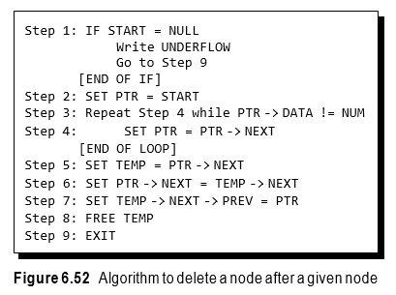
Case 3: The node after a given node is deleted.
In Step 2, we take a pointer variable PTR and initialize it with START. That is, PTR now points to the first node of the doubly linked list. The while loop traverses through the linked list to reach the given node.
Once we reach the node containing VAL, the node succeeding it can be easily accessed by using the address stored in its NEXT field.
The NEXT field of the given node is set to contain the contents in the NEXT field of the succeeding node. Finally, the memory of the node succeeding the given node is freed an

Slide 59
Algorithm Complexities
Operation / type | Singly Linked List | Doubly Linked List | Circular Linked List
Insert at the begin | O(1) | O(1) | O(1)
Insert at the given index | O(n) | O(n) | O(n)
Insert at the end | O(n) | O(n) | O(1)
Delete at the begin | O(1) | O(1) | O(1)
Delete at the given index | O(n) | O(n) | O(n)
Delete the end | O(n) | O(n) | O(1)
Searching an element | O(n) | O(n) | O(n)

Slide 60
References…..
Data structure through C , G.S Baluja
Data structure through C in depth, S.K Srivastava
AV Aho, J Hopcroft, JD Ullman, Data Structures and Algorithms, Addison- Wesley
TH Cormen, CF Leiserson, RL Rivest, C Stein, Introduction to Algorithms, 3rd Ed., MIT Press

Slide 61


www.paruluniversity.ac.in

